Slide 1
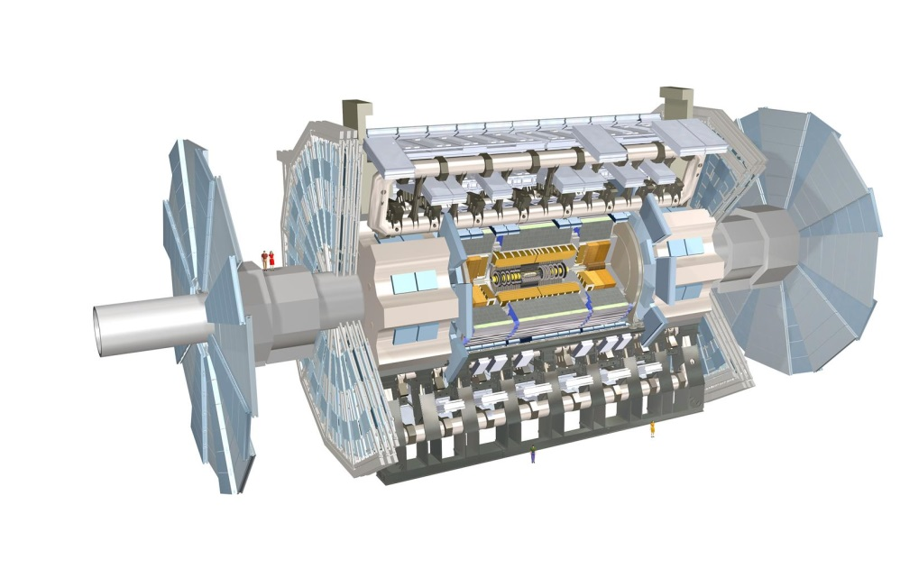
ATLAS Masterclass-in-a-box
Data File 2 (Events 41-80)

Slide 2
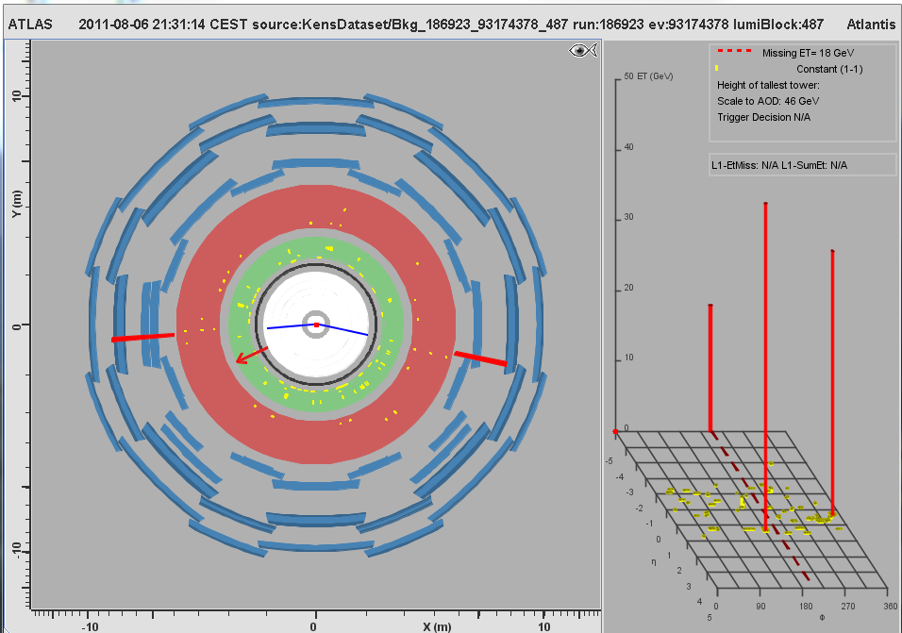
MC Event #041

Slide 3
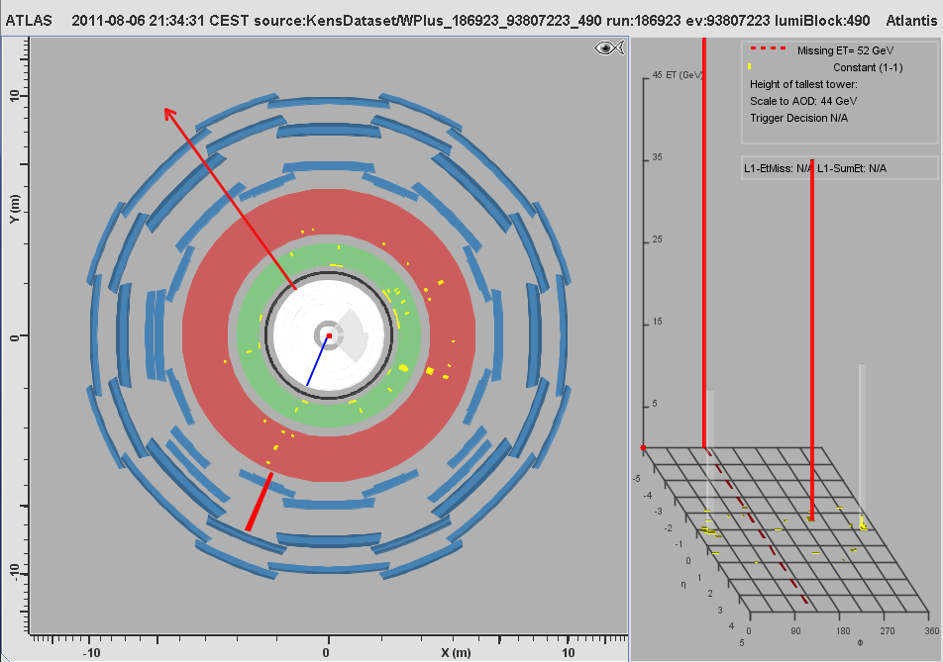
MC Event #042

Slide 4
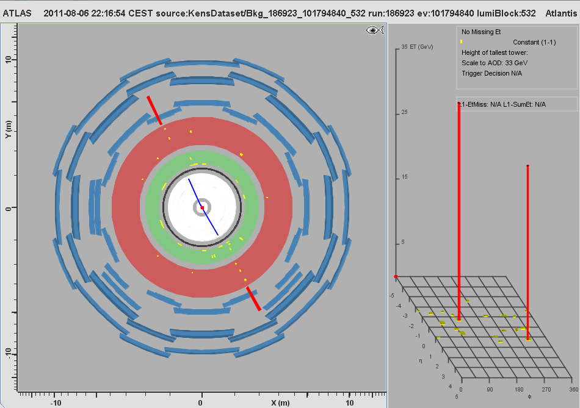
MC Event #043

Slide 5
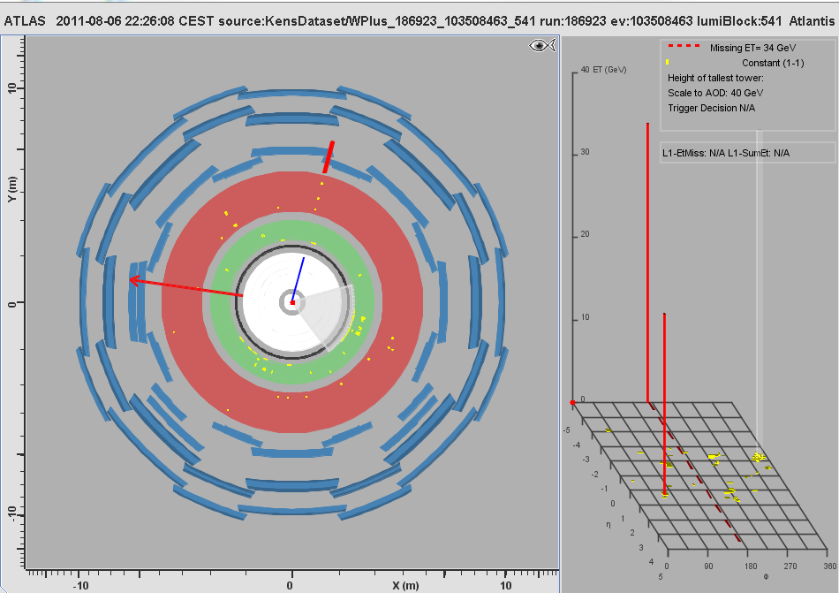
MC Event #044

Slide 6
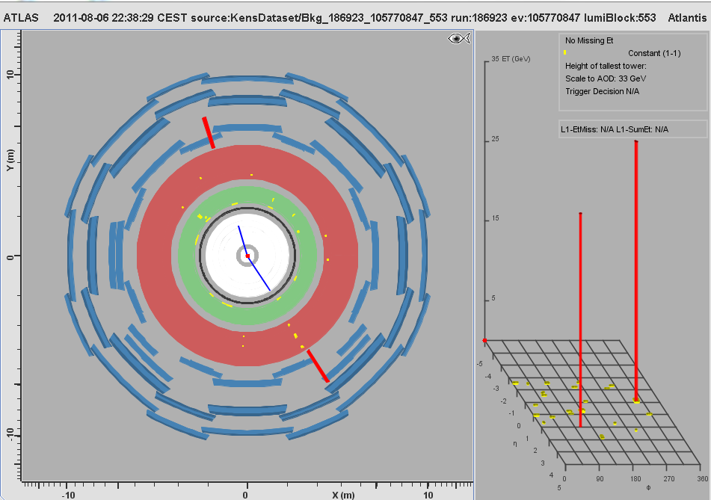
MC Event #045

Slide 7
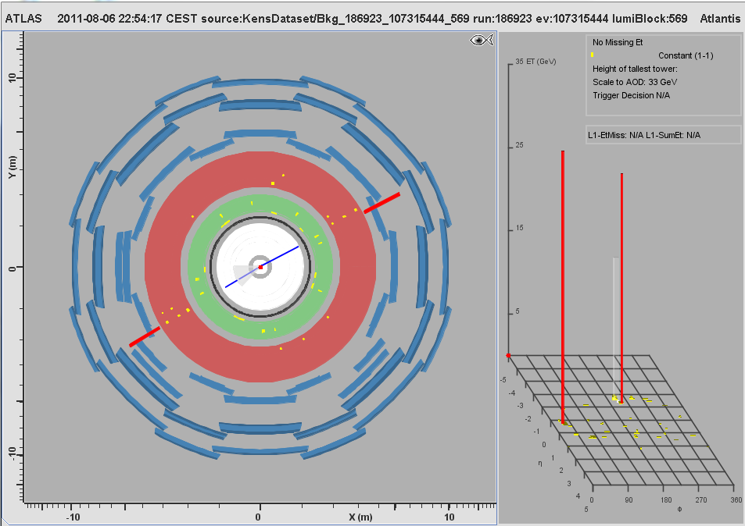
MC Event #046

Slide 8
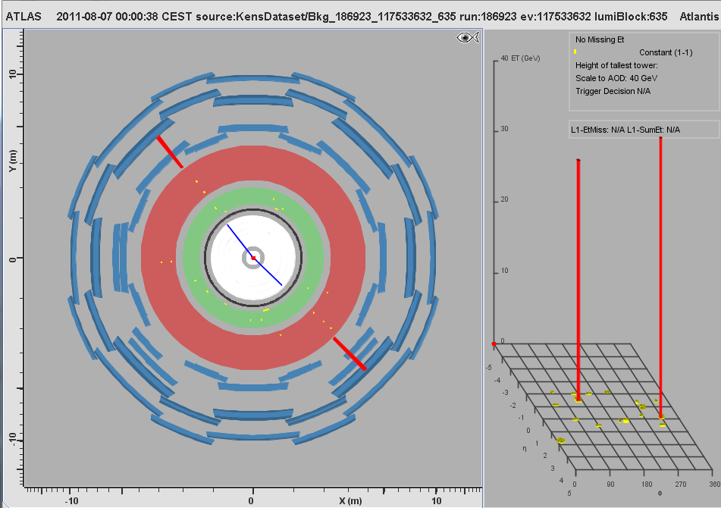
MC Event #047

Slide 9
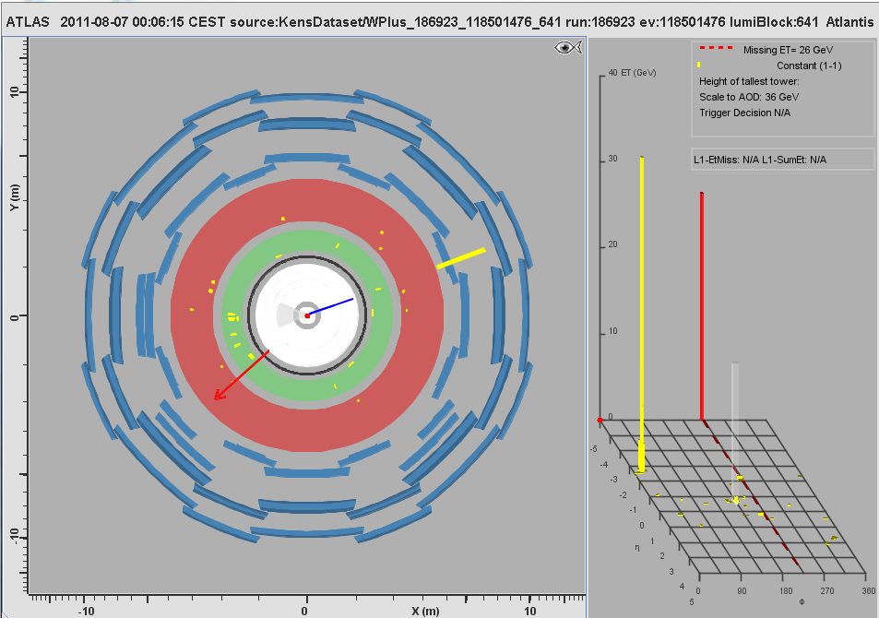
MC Event #048

Slide 10
MC Event #049

Slide 11
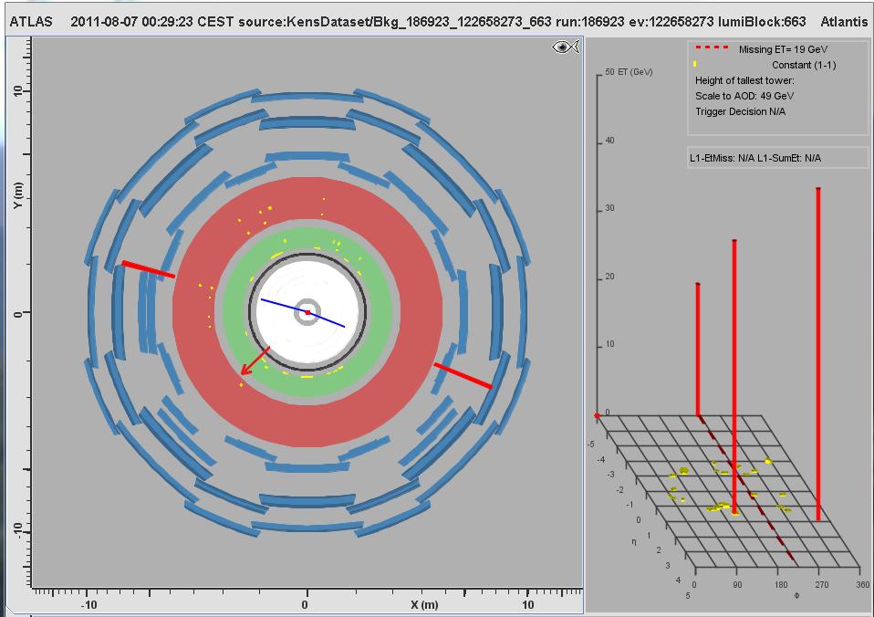
MC Event #050

Slide 12
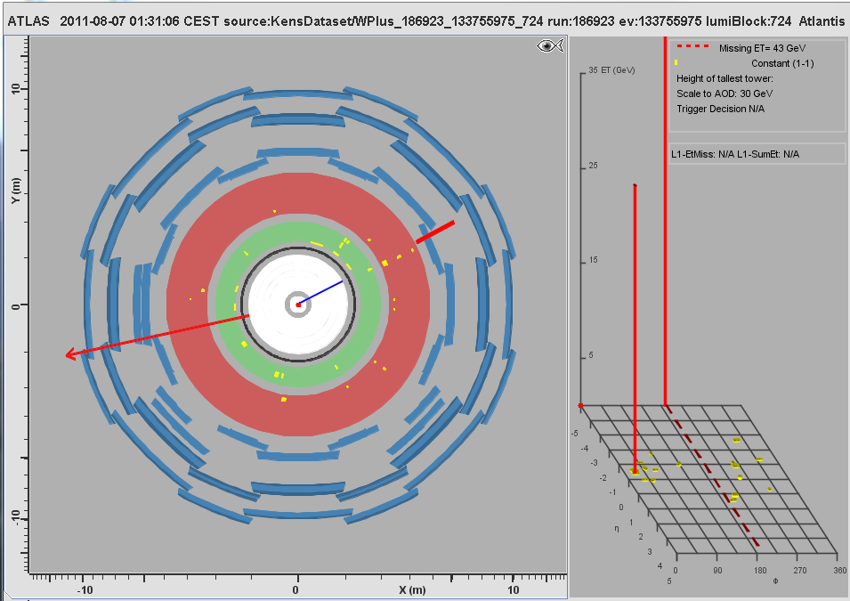
MC Event #051

Slide 13
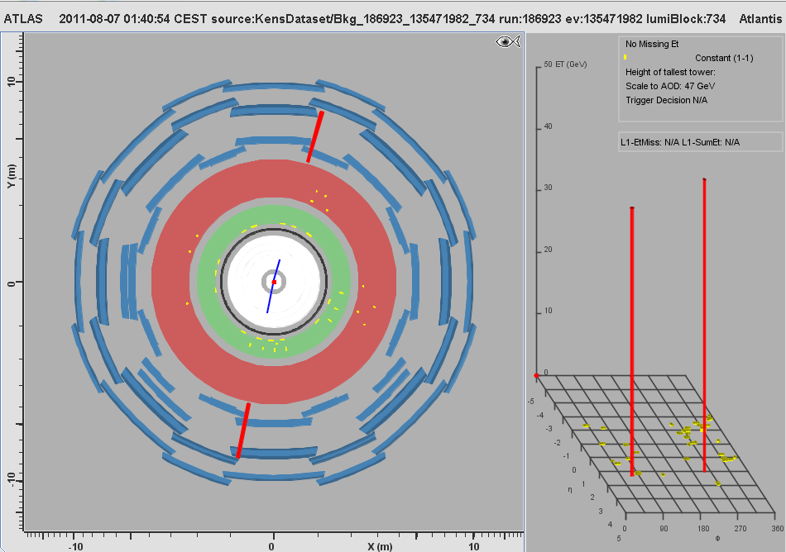
MC Event #052

Slide 14
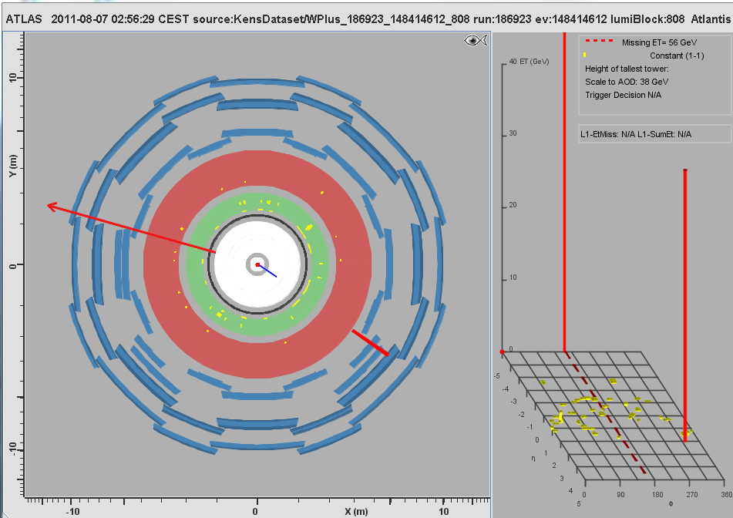
MC Event #053

Slide 15
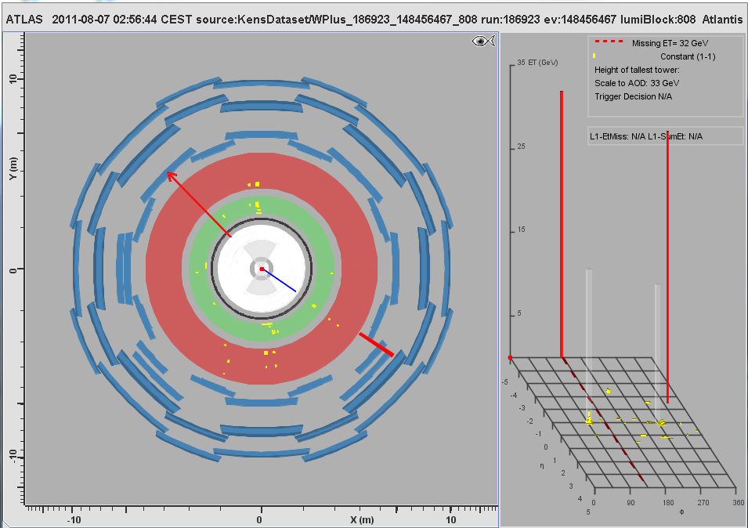
MC Event #054

Slide 16
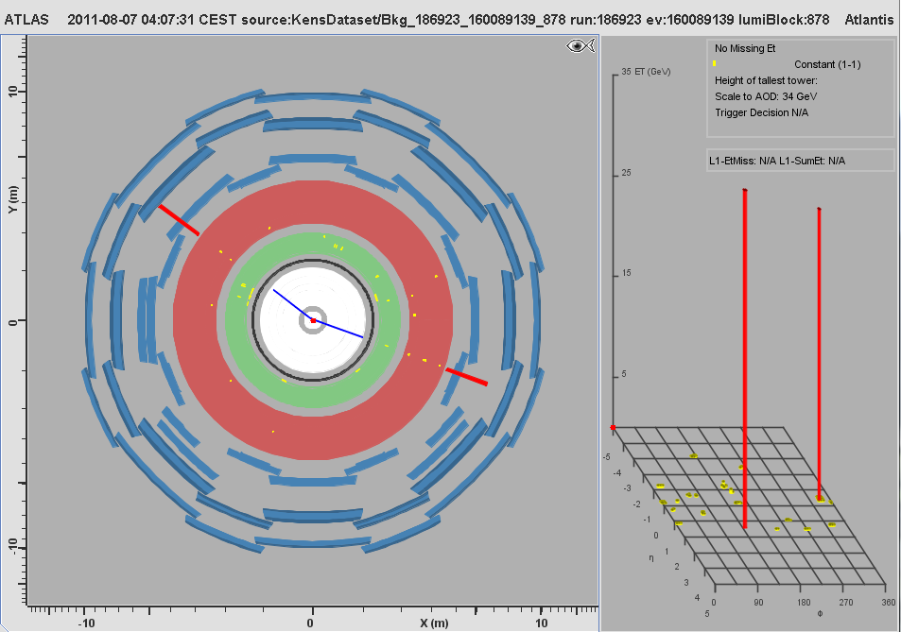
MC Event #055

Slide 17
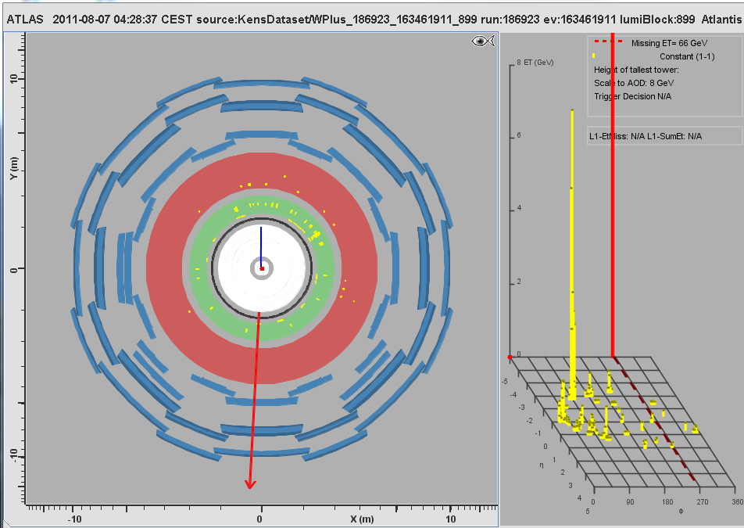
MC Event #056

Slide 18
MC Event #057

Slide 19
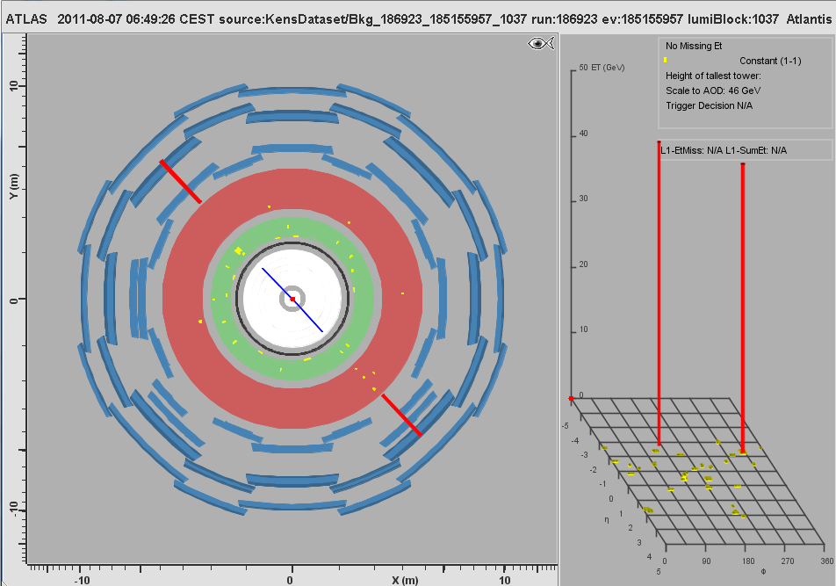
MC Event #058

Slide 20
MC Event #059

Slide 21
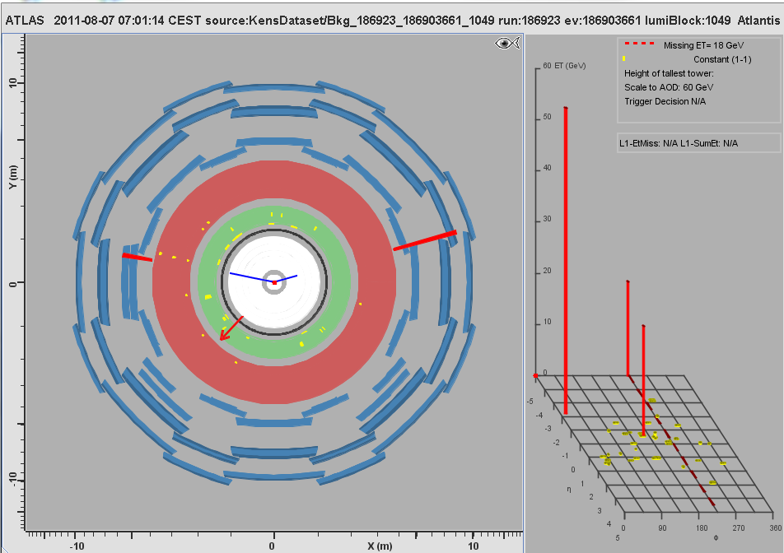
MC Event #060

Slide 22
MC Event #061

Slide 23
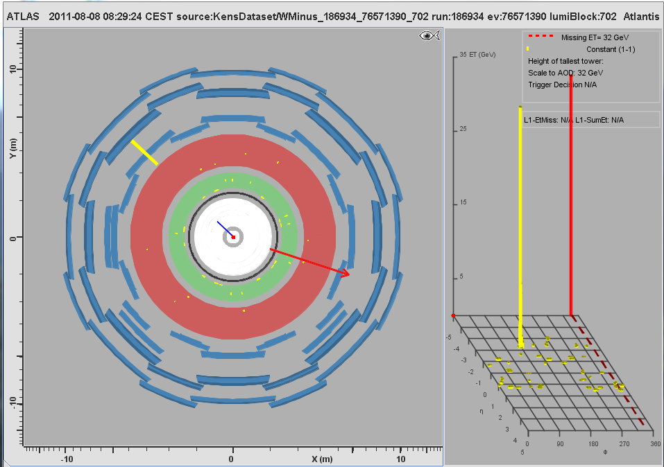
MC Event #062

Slide 24
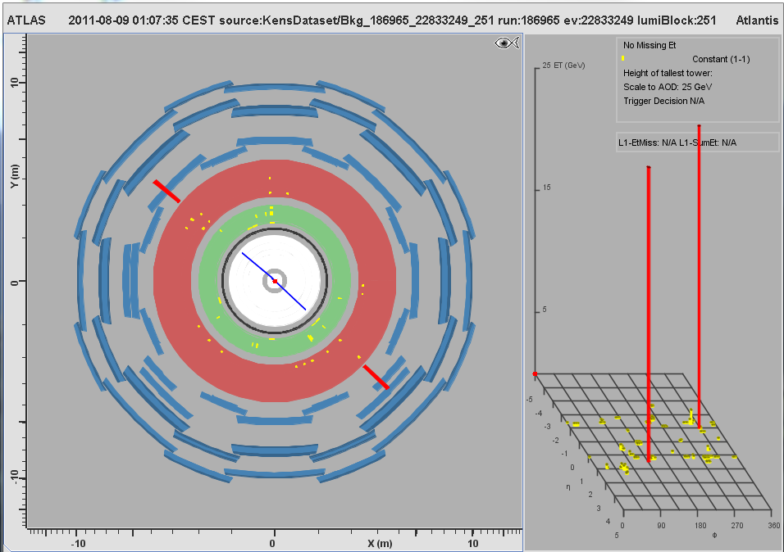
MC Event #063

Slide 25
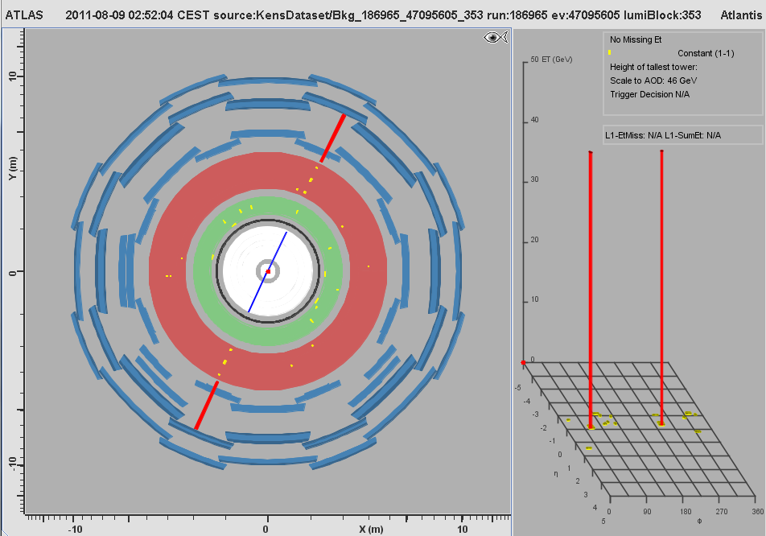
MC Event #064

Slide 26
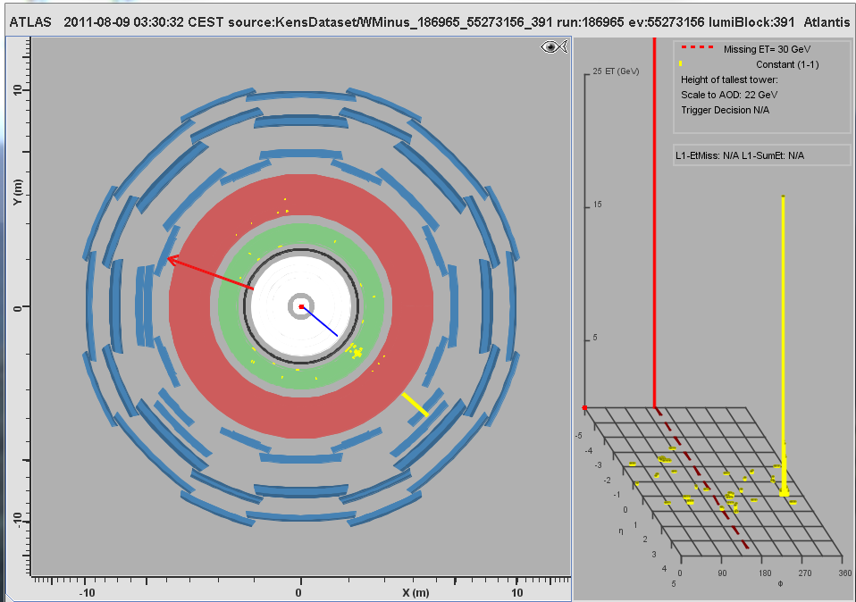
MC Event #065

Slide 27
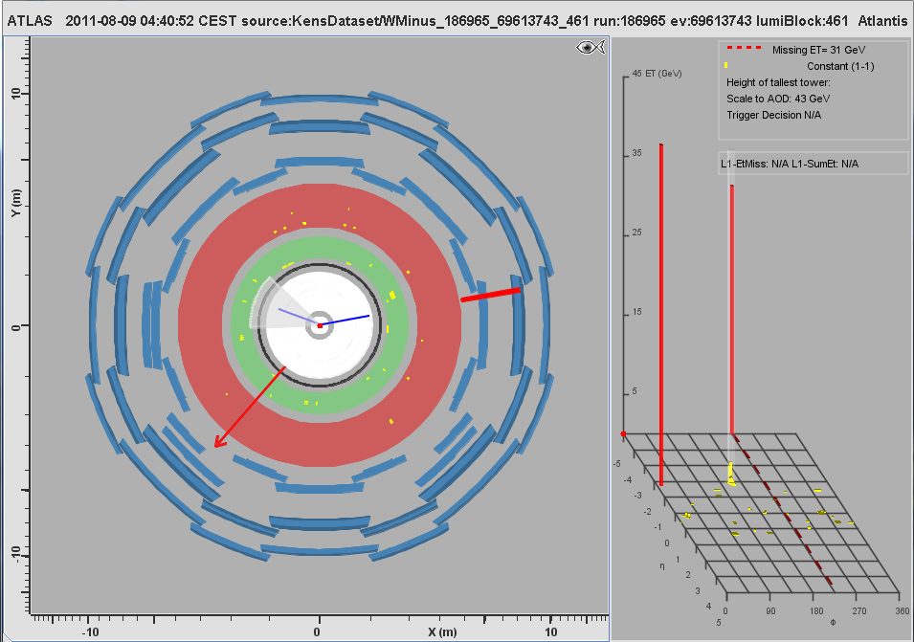
MC Event #066

Slide 28
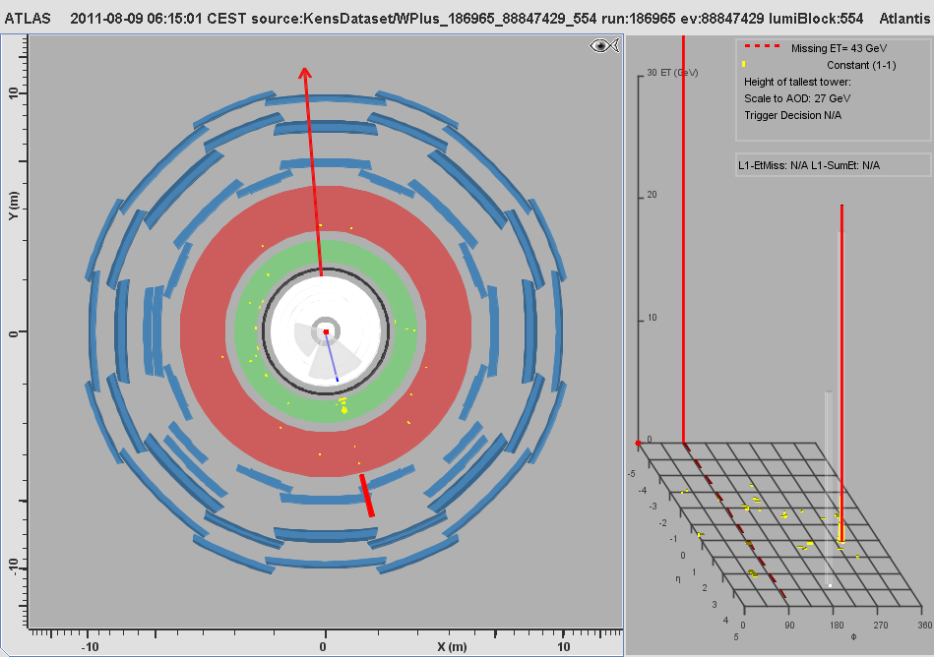
MC Event #067

Slide 29
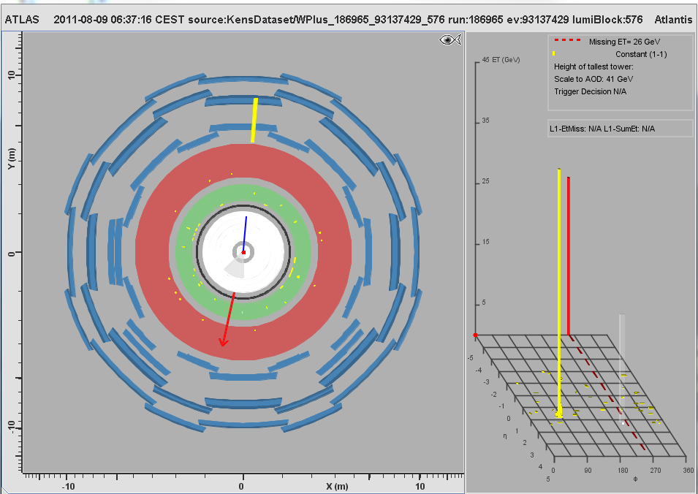
MC Event #068

Slide 30
MC Event #069

Slide 31
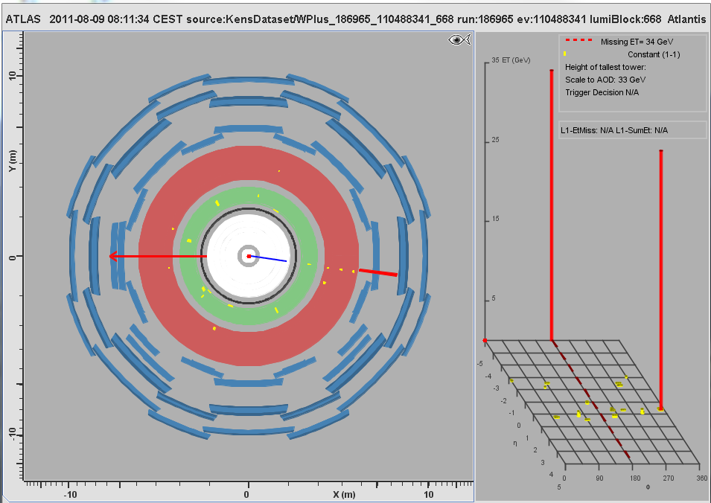
MC Event #070

Slide 32
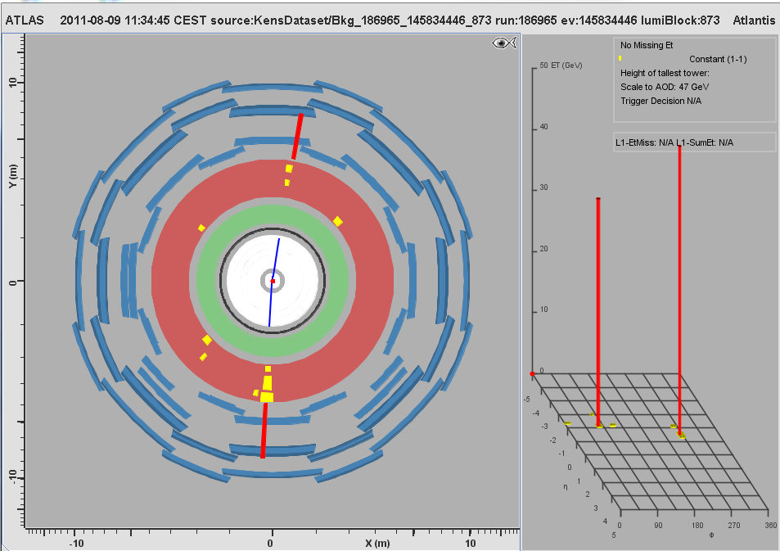
MC Event #071

Slide 33
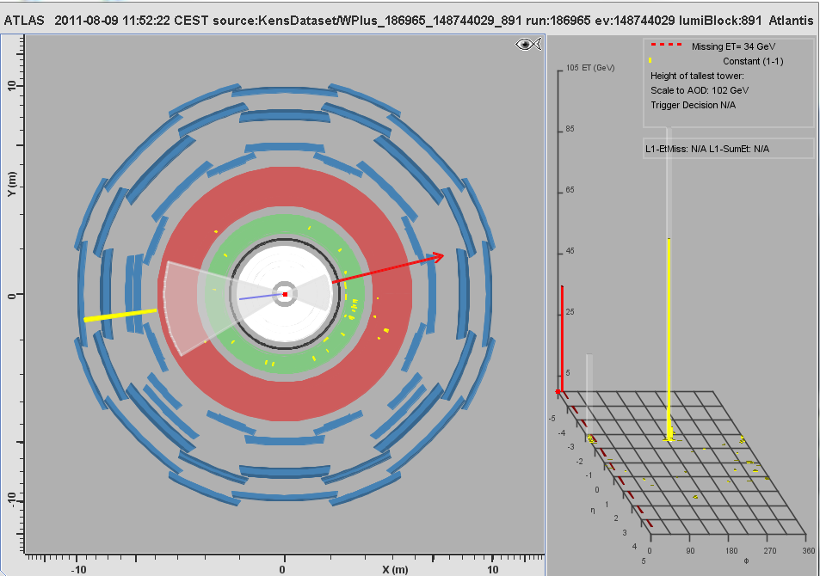
MC Event #072

Slide 34
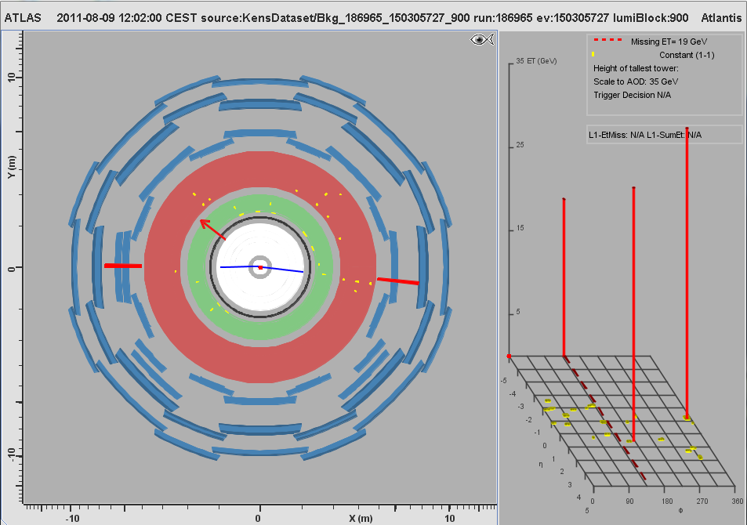
MC Event #073

Slide 35
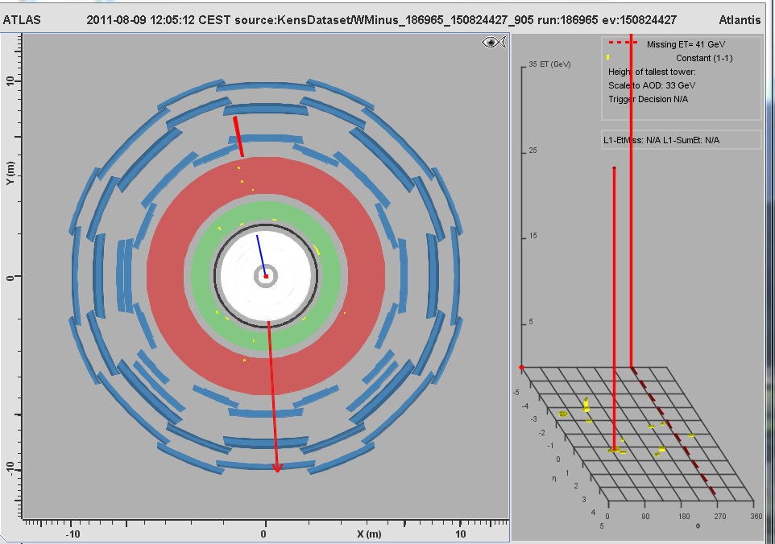
MC Event #074

Slide 36
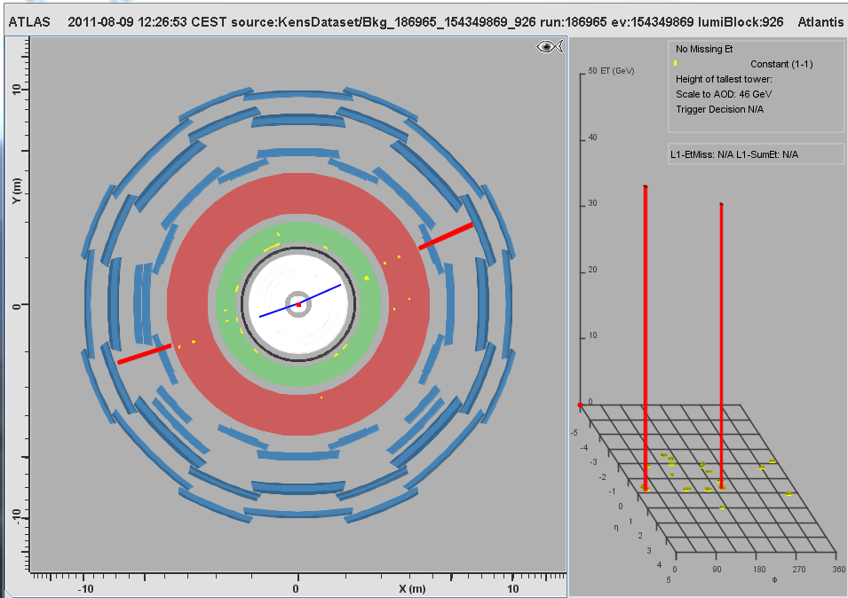
MC Event #075

Slide 37
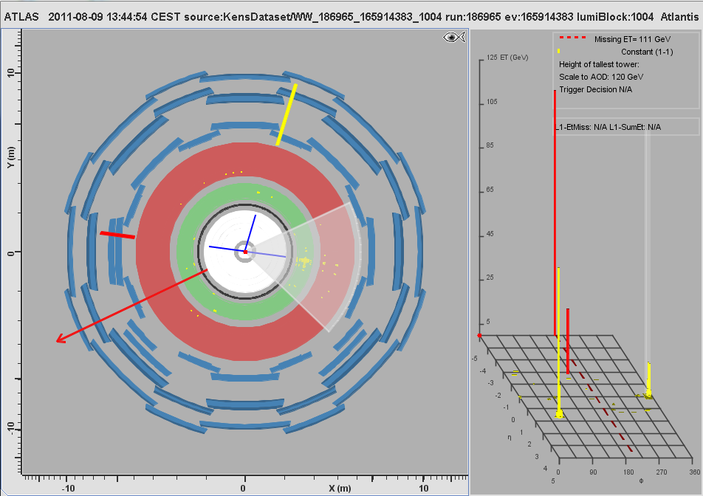
MC Event #076

Slide 38
MC Event #077

Slide 39
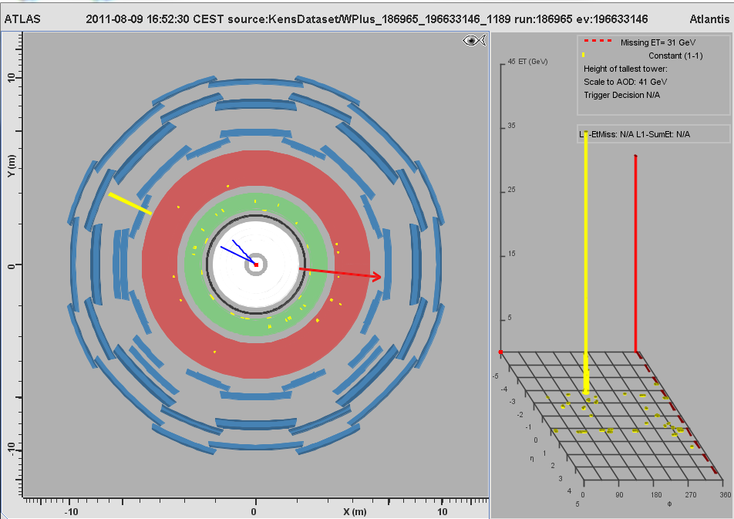
MC Event #078

Slide 40
MC Event #079

Slide 41
MC Event #080

